Slide 1









All-Hands Staff Meeting
February 6, 2024
1

Slide 2

ARC
Accomplishments and
2024 Strategic Priorities
Anna Roach, CEO

Slide 3






Completed 4-year, MTP update with $169B in investments
Applied for over $70M in discretionary funding
Strategic Investments
$169B
Full-scale exercise with over 500 public safety personnel
Concluded Water Management Plan
$500K in discretionary funding to conduct health access study
Healthy, Safe, Livable Communities
500
First-in-the-nation MPO to pursue flexing transportation funds to workforce, investing $1.2M in "Building Georgia"
Metro Atlanta grew by over 66K people
Completed socio economic forecasting & CEDS
Economic Competitiveness
$1M
60,000 public touchpoints for MTP input
Workforce and Health Summits attracting over 225 experts
Website refresh
Stakeholder Engagement
60,000
78.5% Employee Satisfaction
Concluded comprehensive ERF assessment
Classification, compensation & equity studies
New organizational performance framework
Ops Excellence
79%
We Are Awesome

Slide 4
Strategic Investments
Competitive Economy
2024 Transportation Improvement Plan
Launch Building GA
Pursue Climate Grants
Electrification & Freight Studies
Implement Building Pathways to Infrastructure grant with Goodwill
Launch "Building Georgia"
Healthy, Safe, Livable Communities
Diverse Stakeholder Engagement
Operational Excellence
Implement new ERP system
Implement class/comp and equity studies
Launch year of new performance management framework
Cyber security tabletop
Medicare advantage partnership
Celebrate LCI25
Develop regional climate action plan
Carbon reduction plan with targets
Host Agency for National Association of Regional Commissions annual conference
LINK New York (1st for ARC)
Explore regional offices for ARC
We Are Focused

Slide 5







Service & Recognition Awards
New Team Initiatives & Benefits
Parental Leave
Employee Updates & Newsletter
Class & Comp Study
Commuter Benefit
NEXT UP
Enhanced Collaborative Spaces
Structured Collaboration Activities on in-office days
Employee Idea-box
Equity Study
We are “Team First"

Slide 6
We are
ONE
GREAT
ORGANIZATION!

Slide 7
Classification & Compensation and Equity Study Update
Sheila Benefield, Chief Human Resources Officer

Slide 8

Pay Equity and Market Based Findings & Recommendations
Pay Equity Findings – Recommended Salary Adjustments
Out of 57 classifications, only 2 classifications require salary adjustments once internal factors such as merit increases, reclassifications, promotions, negotiated salaries at time of hire, education, experience, and/or longevity were taken in consideration
Manager -1 affected employee
Program/Project Coordinator – 3 affected employees
Market Based Findings – Recommended Position/Band Changes
8 classifications throughout the agency were reviewed and recommended for title and/or band change affecting a total of 9 employees

Slide 9
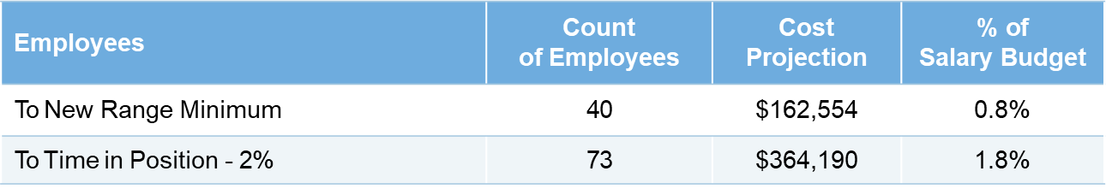
Classification & Compensation – Cost Implementation
The salary structure is based on the 75th percentile with the following cost implementation strategy:
Bring to Time in Position: For each year of time in position, the employee gets 2% to the new range maximum.
* In 2018, the Agency brought salaries to the minimum of New Range based on the Comp and Class study Findings

Slide 10
Classification & Compensation – Structure Implementation
Implementation of findings and recommendations (Q2/Q3– 2024)
New pay and band structure implemented
Salary adjustments related to Equity findings will be addressed first
Other band/title changes implemented
2% TIP adjustments implemented
Targeted communication with Departments/Offices on band/position changes based on body of work and holding individual meetings with each affected staff (Q2-2024)
Initiate appeals process period and criteria for appeals
(Q3/Q4-2024)

Slide 11
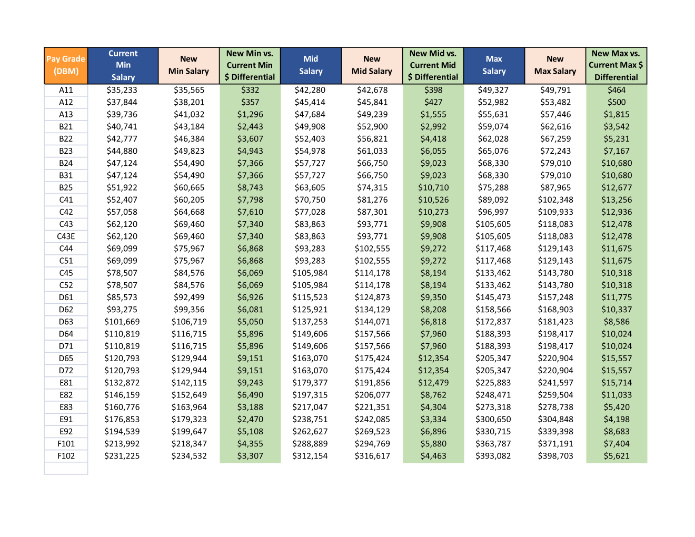
Current Structure vs New Structure

Slide 12
Q&A

Slide 13
Commuter & Parental Leave
Benefits
Kameisha Johnson, Human Resources Manager

Slide 14

Commuter Benefits
The Commuter and Parking FSA Program is an optional benefit that allows employees to set aside pre-tax dollars for the purchase of qualified transit expenses incurred while commuting to and from work. This benefit is offered to fulltime permanent employees, with exception of 100% remote workers.
ARC will contribute $40 per month to an eligible employee’s parking or commuter FSA
January & February funds have been loaded for those eligible employees that enrolled into the plan
The $40 qualifies us as meeting the National Standard of Excellence and qualify for designation under Best Workplaces for Commuters.

Slide 15
Paid Parental Leave
ARC will provide up to two (2) weeks of paid parental leave to eligible regular full-time employees following the birth, adoption, or foster care placement of a child with an employee to give parents time to bond with their new child, adjust to their new family situation and balance personal and professional obligations.
Eligibility Criteria
Time/Duration of Paid Leave
Performance Standardization
Employed with the agency for at least 12 months during the twelve consecutive months preceding the date the leave would begin.
Employee must be taking parental leave for one of the following:
The birth of a child and to care for that child.
The placement of a child for adoption or foster care and to care for the newly placed child under the age of 18. If the adoption involves a child who is incapable of self-care because of a mental or physical disability the age limit of 18 may be waived.
Eligible employees will receive up to a maximum of two weeks
(10 working days) of paid parental leave per calendar year for the birth or adoption of a child.
Approved paid parental leave may be taken at any time during the 12-month period immediately following the birth or adoption of a child. You can only use this benefit once per year.
Any unused paid parental leave will be forfeited at the end of the twelve-month time frame.
Employees that qualify for leave under the Family and Medical Leave Act (FMLA) for the birth, adoption or foster care placement of a child, any paid parental leave taken under this policy will run concurrently with FMLA.

Slide 16
Paid Parental Leave Procedure
ARC will process requests for paid parental leave using the same procedures established for employees to request and receive FMLA leave.
Employees planning to use paid parental leave should provide their supervisor and the Office of Human Resources with no less than thirty (30) days advance notice of the birth, adoption of foster care placement of a child.
When the birth, adoption or foster care placement is not foreseeable, employees should provide with as much notice as is both possible and practical.
A Paid Parental Leave Request Form and supporting documentation is required and needs to be submitted to the Office of Human Resources within 30 calendar days of the birth or adoption.
Birth: A copy of your child’s birth certificate or hospital birth confirmation.
Adoption: Official documentation from a Court, Agency, and/or Attorney.

Slide 17
Patient Assistance Program
Scott Hopke, Director AMWINS
Cynthia Pannullo, Vice President MMA

Slide 18





Amwins Assist Now Available!
What Is Amwins Assist
$0 Drug Copay
It is a cost-saving program that will save eligible members on select prescription drugs covered under the prescription drug insurance.
Once enrolled in the manufacturer’s program, you will have a $0 out-of-pocket cost for the secured drug.
How Does it Work
Are You Eligible
Select drug manufacturers offer assistance programs that give free drug directly to patients. These programs are different than coupon programs that only cover a portion of the drug cost.
Our Program Coordinators work with you, your provider, and the manufacturer to see if you are eligible for free drug supply.
Once approved, your select prescription drug will be supplied directly from the manufacturer.
Not all drugs are eligible for assistance and not all members will qualify for the manufacturer program.
Amwins Contacting You
If you are on an eligible drug, a Program Coordinator will contact you to discuss the savings opportunity and see if you are eligible for assistance.
To start the review process, a Program Coordinator must speak with you.

Slide 19
Employee Performance Framework
Sheila Benefield, Chief Human Resources Officer
James Husserl, Chief Financial Officer

Slide 20



Key Checkpoints
Performance Management Framework
January | February | March
Launched New Performance Framework | Review and Approval of Employee Objectives | 1st Quarter Check-In
New Performance Management system went live on January 23, 2024 Individuals entered 2024 objectives on or before January 31st – 99% Completion Rate | Managers to review and approve employee objectives by February 15th Maximum of 7 objectives allowed Ongoing technical assistance provided by IT and HR | Journal entry section opens for employees on March 15^{th,} with a due date of March 31st Journal entry section opens for managers on April 1st,with a due date of April 15th During the check-in, employees reviews their objectives with Managers Managers provides feedback on performance Journal entries are documented in NEOGOV

Slide 21
Cyber Security Awareness
Steve Williams, Chief Information Technology Officer
Ray Randolph, Deputy Chief Information Technology Officer

Slide 22
2024 Cyber Attacks
Fulton County Georgia Cyberattack: Phones, Tax And Court Systems Impacted
AnyDesk Hacked: Popular Remote Desktop Software Mandates Password Reset
Cuba Delays Fuel Price Hike, Cites Cyberattack
Hackers Steal $112 Million Of XRP Ripple Cryptocurrency
Romanian Chamber of Deputies
Sweden data center attack
Nevada Gaming Control Board
Ukrainian Gas Supplier's Data Center
Hewlett Packard Enterprise
911 Dispatch System In Bucks County, Pennsylvania
Ukraine's Monobank
Financial Platform Payoneer
Microsoft
After Ransomware Claims, Xerox Says Subsidiary Hit With Cyberattack
Hackers Break Into Victoria, Australia Court Recordings Database
Massachusetts Hospital Diverts Ambulances After Cyberattack
Ukraine 'Blackjack' Hackers Hit Jackpot In Russia
Switzerland Hit By Cyberattack After Ukraine President's Visit
Ransomware Hits Spanish City Of Calvià In Majorca
Ransomware Gang Targets Nonprofit Providing Clean Water To World’s Poorest
Ransomware Attack On US Navy Shipbuilder Leaked Information Of Nearly 17,000 People
School Software Breach Reveals Private Data On Millions Of Users
Ransomware Wrecks Paraguay's Largest Telco
Online Services Down For German Craft Associations Following ‘Security Incident’
SEC Blames Hack For Incorrect Post About Bitcoin ETF Approval
Kenya Airways Hacked, Sensitive And Confidential Files Leaked
Mortgage Firm LoanDepot Cyberattack Impacts IT Systems, Payment Portal
Law Firm That Handles Data Breaches Was Hit By Data Breach
Weak Password Causes Disaster For Spain’s No. 2 Mobile Carrier
‘Large-Scale’ Cyberattack Hits French Township, All Local Services Down

Slide 23
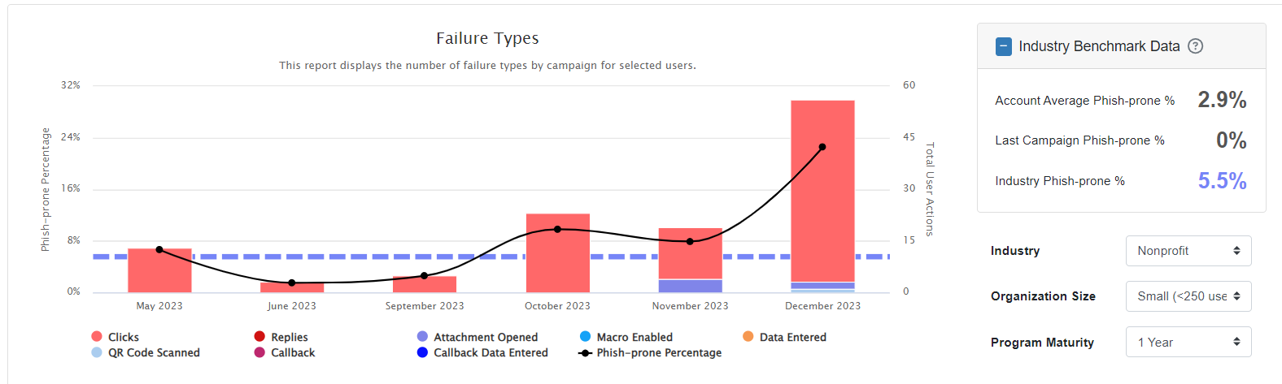
Phishing Risk Results

Slide 24
What Can Happen
Financial Loss
Disruption of Service
Ransomware Attacks
Legal and Regulatory Consequences
Malware Infections
Identity Theft

Slide 25
Cybersecurity Prevention Measures
Stay Vigilant (especially using out of office Wi-Fi)
Lock Your Workstations and Phones
Don’t Share Credentials
Be Aware of Phishing Attempts
Run Updates (Computers, Laptops, Phones)

Slide 26
Questions “Remember hackers haven’t changed only the tools”

Slide 27
Operational/Regional Priorities
Mike Alexander, Chief Operating Officer

Slide 28








Chief Operating Officer – Priorities
Mobility Services will conduct a Regional Commuter Survey to collect and analyze commuting for Atlanta region. Survey responses will be statistically significant to the county or sub-regional level
The post-pandemic housing shortage continues to intensify as rapid economic and population growth continues. Housing strategies must be pursued to limit potential damage to the region’s economic competitiveness.
MOBILITY
HOUSING
WATER ACCESS
EQUITY
The Metropolitan North Georgia Water Planning District will begin visioning for the next plan update, with work in 2024 focusing on the review and revision of the Water Resources Management Plan's policy goals and planning principles
Through the Bipartisan Infrastructure Law (BIL), ARC is pursuing discretionary grant applications to “Reconnect the Region.” Examples include transportation projects to advance trails, transit and other projects that connect southside communities to employment centers.
2024
OPERATIONAL
PRIORITIES
URBAN AREA SECURITY
CLIMATE
The Urban Area Security Initiative (UASI) will conduct a Threat Hazard Identification and Risk Assessment (THIRA) and a Downtown Atlanta Evacuation Plan as part of a strategy to prepare for potential threats and evaluate the best responses
North Georgia is the epicenter of the largest concentration of investment in clean energy and EV manufacturing in the United States. Planning for this growth is critical through ARC planning initiatives such as the Regional Transportation Electrification Plan and the Climate Pollution Reduction Grant.
HEALTHCARE
TRANSIT
Grow Medicare Advantage plan partnerships with healthcare payors. ARC will pursue recommendations to evaluate and build infrastructure to enable growth of revenue-generating partnerships.
Expansion of regional transit is one of the most important factors in preserving regional quality of life. ARC will act as a resource to assist regional communities in this process.

Slide 29
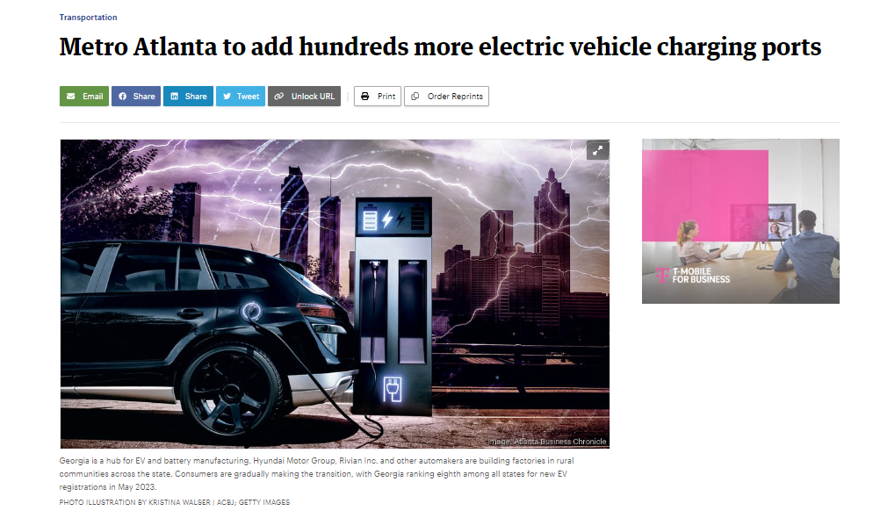
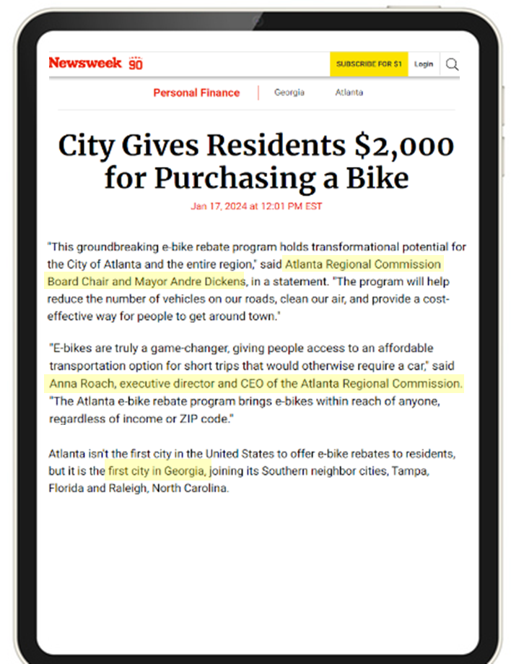
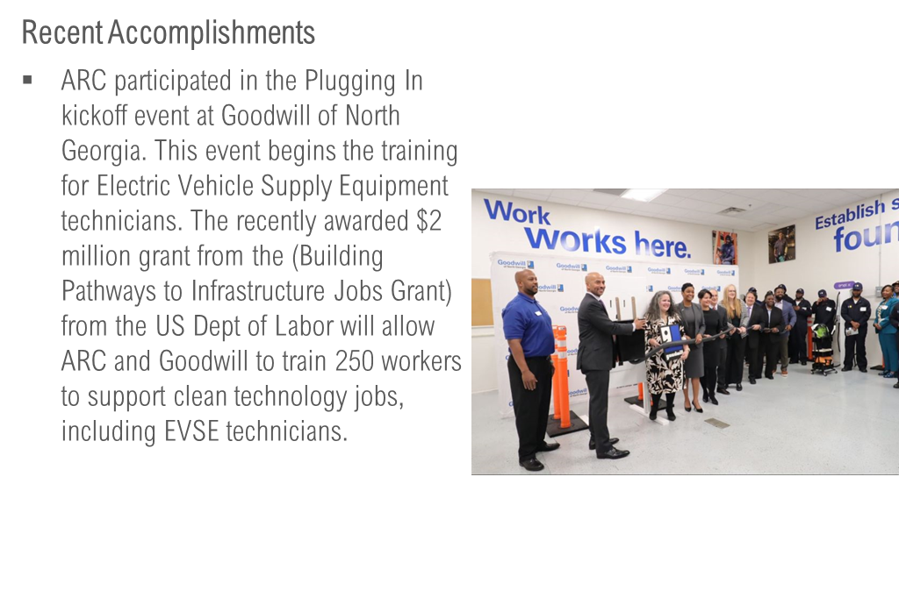
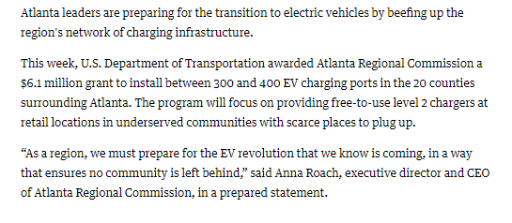
Operational Successes

Slide 30
Department Highlights
Department Heads

Slide 31
Q & A

